Slide 1


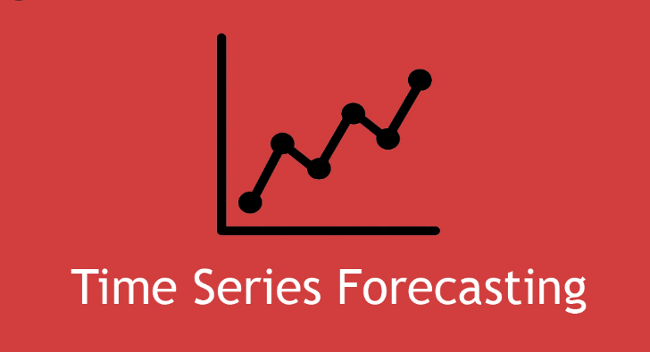
P-303 Time Series Forecasting
Group 4
SANDRA R MADHU S S
SMITA S AJITH N G
R ASWATHI ANISHA M

Slide 2
CONTENT :
Introduction of Time series Forecasting.
Applications of Time series Forecasting.
Problem Statement.
Steps performed.
EDA.
Model Identification.
Model Building & Fitting.
Deployment.
Conclusion.

Slide 3
“Time-series” is a series of observations that are recorded over a period of time. The “Time series” forecasting problem analyzes patterns in the past data to make predictions about the future.
Introduction :

Slide 4
Applications :
Finance: Stock Price Prediction, Credit Risk Assessments.
Economics: Predicting GDP, Inflation.
Energy: Load Forecasting.
Meteorology: Weather Forecasting.
Healthcare: Disease outbreak prediction, Patient Admission Prediction.
Marketing & Sales: Sales forecasting.

Slide 5
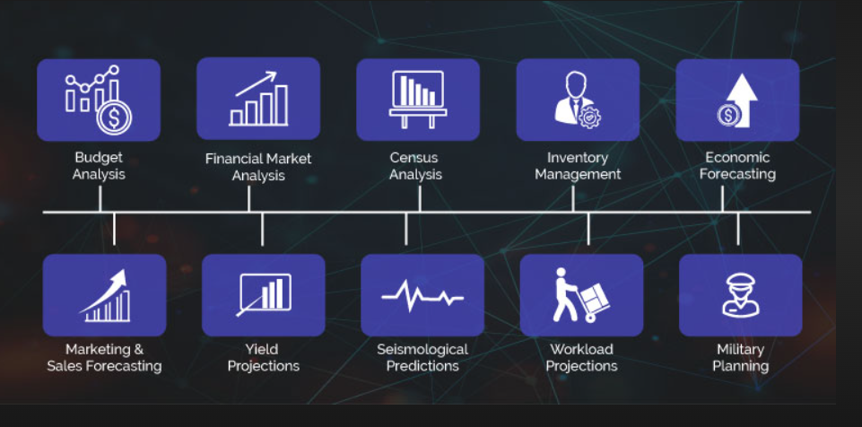
Applications of Time Series Forecasting:

Slide 6
Problem Statement :
Given the Date, Predict the Stock price.
Double Click!

Slide 7
Steps Performed :
Data Pre-processing: Data Cleaning, Re-sampling, Normalising or Scaling.
EDA: Data Analysis and Visualization
Model Selection:
Data Splitting:
Model Training:
Model Validation:
Forecasting:
Deployment:

Slide 8
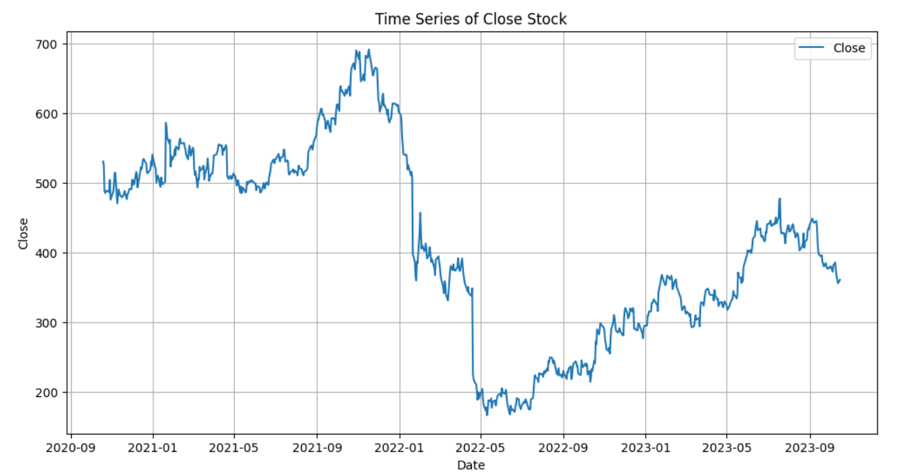
Data Visualization: Line Plot
The line plot shows that data is not stationary

Slide 9
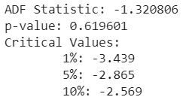
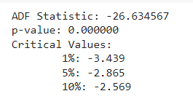
AD Fuller Test :
ADF test is performed to prove stationarity in data.
We used the following Null and alternative Hypothesis:
H₀: The time series is non-stationary.
H₁ : The time series is stationary.
If the p-value from the test is less than some significance level (e.g. α = .05), then we can reject the null hypothesis and conclude that the time series is stationary.
Before Differencing
After Differencing

Slide 10
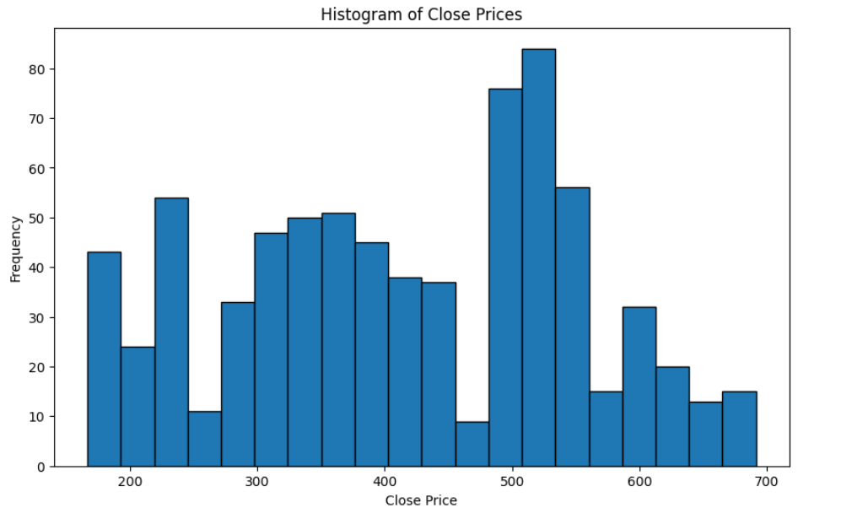
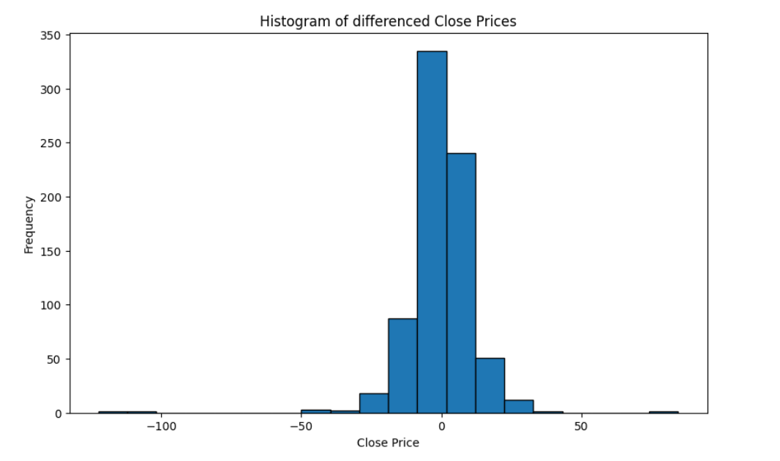
Histogram of Close Price Before and After Differencing :
Not Normally Distributed
Normally Distributed

Slide 11
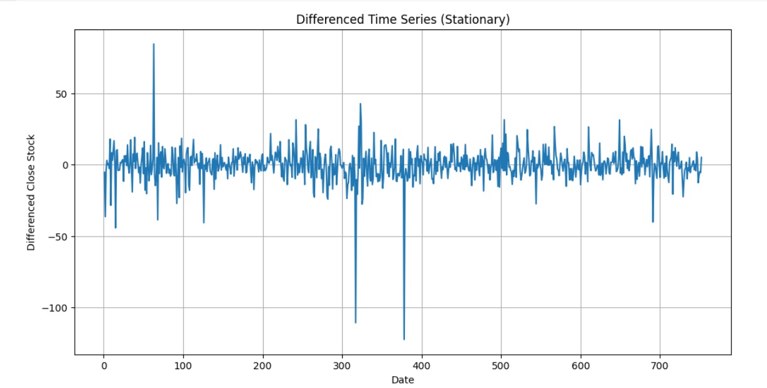
Line Plot after differencing :
Data is stationary.

Slide 12
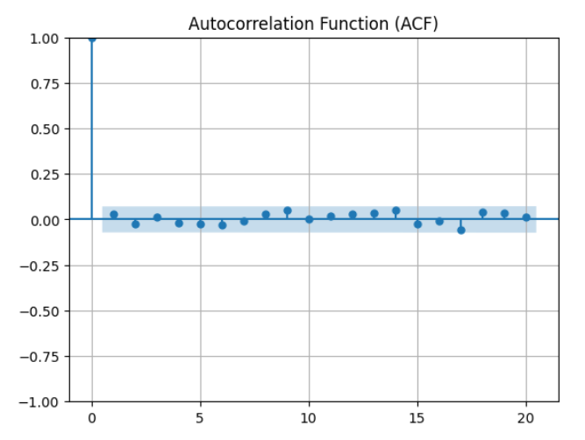
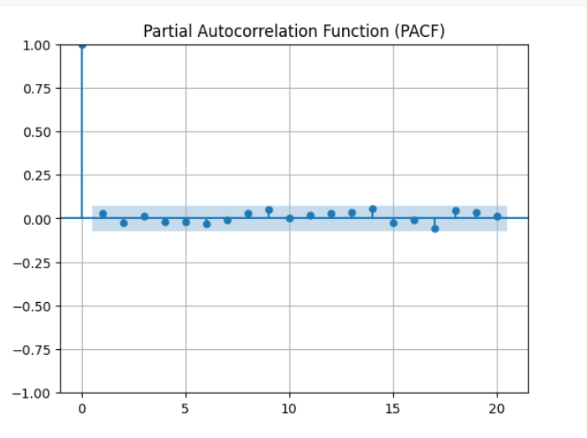
ACF & PACF :
By checking ACF and PACF plot of stationary data, it is clear that after differencing
data became iiv (independent and identical variables),
variable which has no AR or MA component. i.e., there is no trend and seasonality.
There is no significance corresponding to any lag.

Slide 13
ARIMA : Autoregressive Integrated Moving Averages :
Data Preparation.
Differencing.
Model Identification.
Model Evaluation.

Slide 14
Auto ARIMA Model :
By using Auto ARIMA function :
Starting from p=0 & q=0 Upto p=10 & q=10
We get best fit ARIMA model for the given data is ARIMA of (0,1,0)(0,0,0)[0] intercept.
It shows neither AR not MA components, only differencing occurred
After differencing it became iid variable.
AIC vale of the model is 4740.125

Slide 15
LSTM-Long Short Term Memory :
Feature Scaling, using Min-Max scaling.
Splitting Data to Training and Testing Data sets.
Data Sequencing.
Model Building.
Compiling and model fitting
Testing.
Forecasting.

Slide 16
Scaling , Splitting and Sequencing the Data
Min-Max scaling ensures that all features have the same scale and range, making it suitable for LSTM and other deep learning models.
Splitting your data into training and testing datasets is a fundamental step in training any machine learning or deep learning model, including Long Short-Term Memory (LSTM) networks.
LSTMs are designed to process sequential data, and proper data sequencing is essential to ensure that the network can capture temporal dependencies and patterns in the data effectively.

Slide 17
Model Fitting:
"Model fitting" in the context of LSTM (Long Short-Term Memory) and deep learning refers to the process of training the model on your data. This process involves iteratively adjusting the model's weights and biases to make it learn patterns, relationships, and representations within the data.

Slide 18
Model Building and Compiling.
LSTM model building involves constructing a neural network tailored to sequence data. This architecture typically includes one or more LSTM layers, along with additional layers like Dense and Dropout.
Compiling in LSTM, as in any deep learning model, refers to the configuration of certain training parameters, loss functions, and optimization algorithms before the model starts learning from the data.

Slide 19
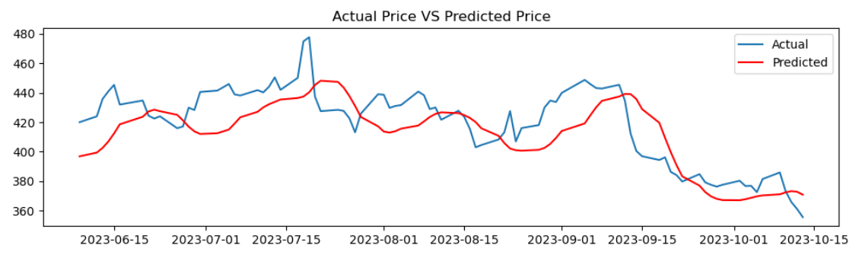

Slide 20
SUMMARY AFTER MODEL FITTING :
MODEL | RMSE
Exponential model | 136.004
Quadratic model | 295.82
Additive Model | 204.564
LSTM | 0.03423
RMSE is least in LSTM. We used LSTM for deployment

Slide 21
LSTM MODEL-2
Model Type: It's a sequential model, which means that the layers are stacked sequentially.
Layers:
(i) LSTM Layer (lstm_3): This is a Long Short-Term Memory (LSTM) layer, which is a type of recurrent neural network (RNN) layer. It has 10,400 parameters, and it outputs a tensor with a shape of (None, 50), meaning it has 50 units or neurons.
(ii) Dense Layer (dense_1): This is a fully connected layer (dense layer) with 1 neuron (output unit). It has 51 parameters.
Test Loss: 0.0007321983575820923 This value is close to zero, indicating that the model's predictions are very close to the actual values in the test data.

Slide 22
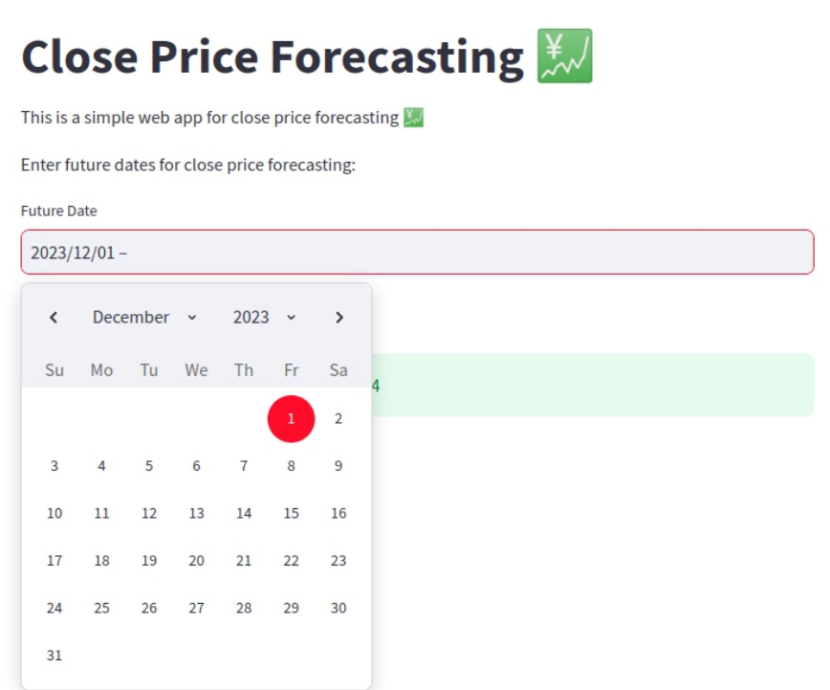
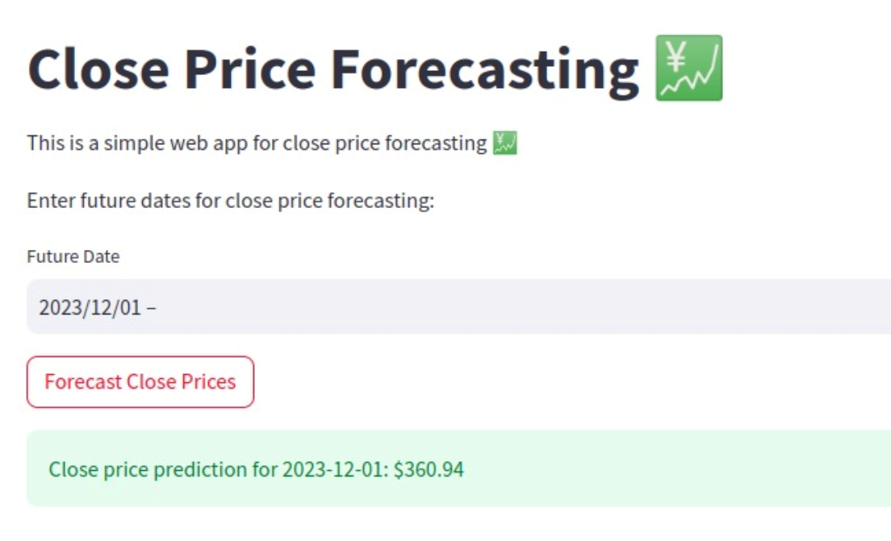
Deployment

Slide 23
CONCLUSION :
We can conclude that as per the RMSE values the least error is in LSTM model and hence we used LSTM to deploy the Model and are being able to predict the Stock Value in on a Future date.

Slide 24
Risk and Uncertainty:
Stock market prediction is inherently uncertain, and results should not be interpreted as guarantees. Investors should diversify their portfolio and seek professional advice.

Slide 25


